Slide 1
DOWNSTREAM AND IN SITU GENESIS OF
MONSOON LOW-PRESSURE SYSTEMS IN
COUPLED MODELS, 60
Seventh WMO International Workshop on Monsoon (IWM-7)
22-26 March, 2022, IMD, MoES, New Delhi, India
K. S. S. Sai Srujan¹ and S. Sandeep¹
1Centre for Atmospheric Sciences, Indian Institute of Technology Delhi, New Delhi, India-110016
Presented by:
K. S. S. Sai Srujan
srujansai1997@gmail.com
Objective of the paper : The objective of the paper is to propose an automated algorithm to classify LPS genesis over the BoB, broadly into in situ (due to the local processes) and downstream amplification (in which the westward propagating atmospheric disturbances from the Pacific amplify over the BoB). Despite its importance to the water security of the country, the fundamental genesis mechanisms of LPS are still not fully understood. In addition, although the current generation of general circulation models simulate LPS but they have relatively low skill in capturing LPS activity. Furthermore, in situ and downstream LPS genesis are not quantified in coupled models yet. Using this algorithm, we tracked the LPS activity in 11 models from the CMIP5.

Slide 2
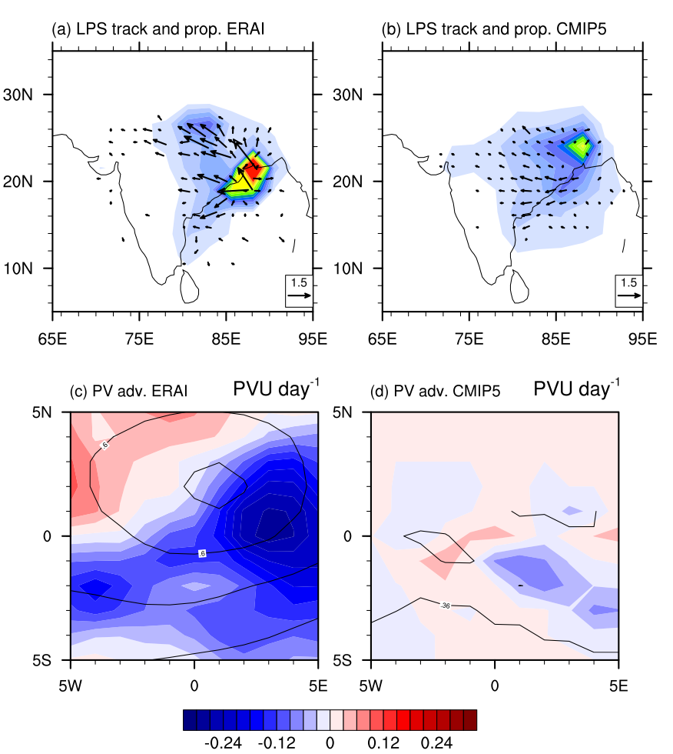
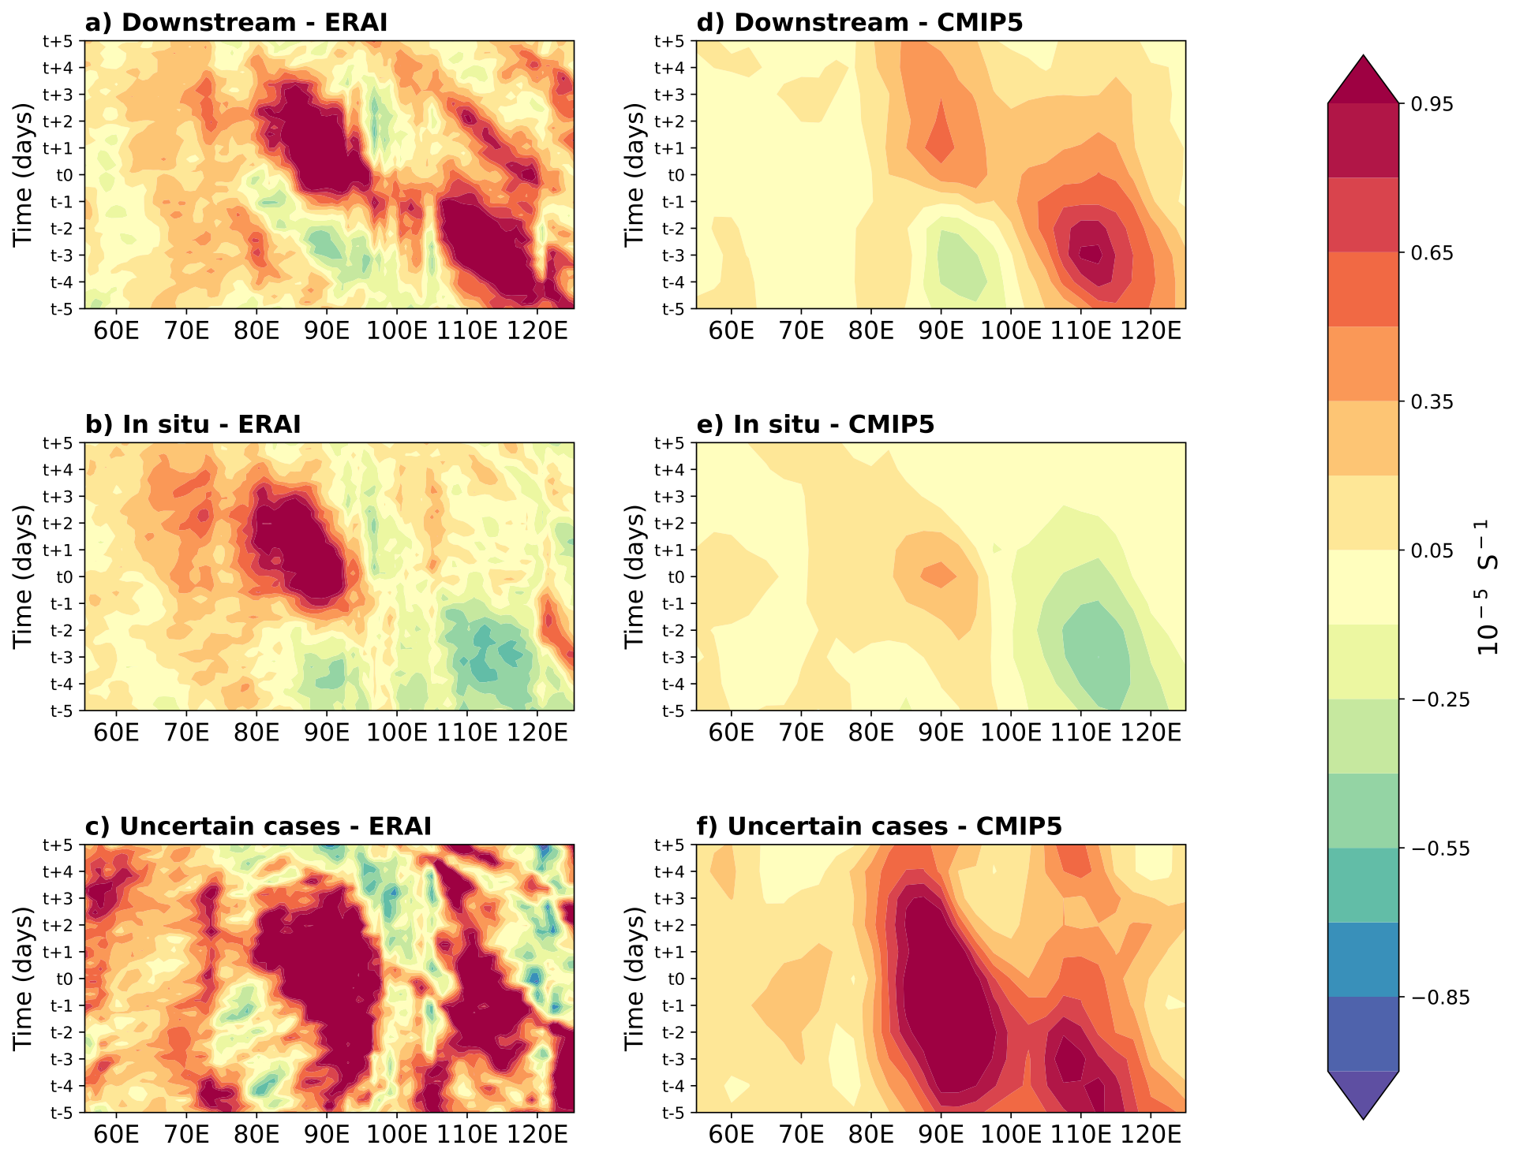
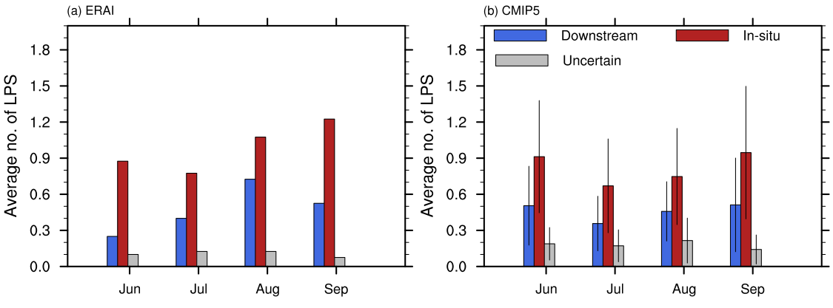
Data, Methodology, Results & Summary
Data & Methodology: Daily mean sea level pressure, relative vorticity (𝜁) and winds at 850hPa, potential vorticity (PV) and temperature at 500hPa from ERAI and 11 CMIP5 models are considered for this study. The LPS activity in the models are tracked using the algorithm developed by Praveen et al. (2015). The LPS are classified broadly into in situ and downstream based on the propagation of 𝜁 anomaly from Pacific by defining a criteria and thresholds. This algorithm is automation of manual classification done by Meera et al. (2019), but with slightly modification of defining an additional category named “uncertain events”. Uncertain events are LPS genesis where both in situ and downstream mechanisms are present. The information regarding the models and classification criteria are mentioned in Srujan et al. (2021).
Reference: Praveen, V., Sandeep, S., & Ajayamohan, R. S. (2015). On the Relationship between Mean Monsoon Precipitation and Low Pressure Systems in Climate Model Simulations, Journal of Climate, 28(13), 5305-5324.
Fig. 1 June to September climatology of track density (units: no. of low-pressure system [LPS] per grid per season) and LPS propagation vectors (units: m s−1) for (a) ERAI and (b) multi-model ensemble of CMIP5; storm centered composites of 500 hPa–300 hPa average potential vorticity (contours; units: PVU) and potential vorticity advection (shading; units: PVU day−1) for (c) ERAI, and (d) multi-model ensemble mean of CMIP5.The latitudes and longitudes in (c) and (d) are relative latitudes and longitudes with respect to the LPS center. The calculations are done for the period 1979–2005.
Fig. 2 Lead lag composite of 𝜁 at 850hPa
Summary: 1) Substantial inter model variability has been observed and all models have predominantly in situ LPS genesis mechanisms inline with the observations.
2) A weaker PV advection causes a weaker and incoherent propagation of LPS in CMIP5 models.
3) The core region of LPS genesis is shifted northward with majority of them forming over land in CMIP5 models.
4) The genesis of downstream LPS happens too early in monsoon season(June and July) whereas it peaks in August and September in observations.
Fig. 3 Average monthly frequency of the downstream, in situ, and uncertain LPS for (a) ERAI reanalysis for the period 1979–2017 and (b) ensemble mean of 11 CMIP5 models for the period 1979–2005. The error bars in (b) indicate the inter-model spread (±1 standard deviation) in the LPS frequency for each month.
Publication: Srujan, K. S. S. S., Sandeep, S., & Suhas, E. (2021). Downstream and in situ genesis of monsoon low-pressure systems in climate models. Earth and Space Science, 8, e2021EA001741. https://doi.org/10.1029/2021EA001741

